Slide 1

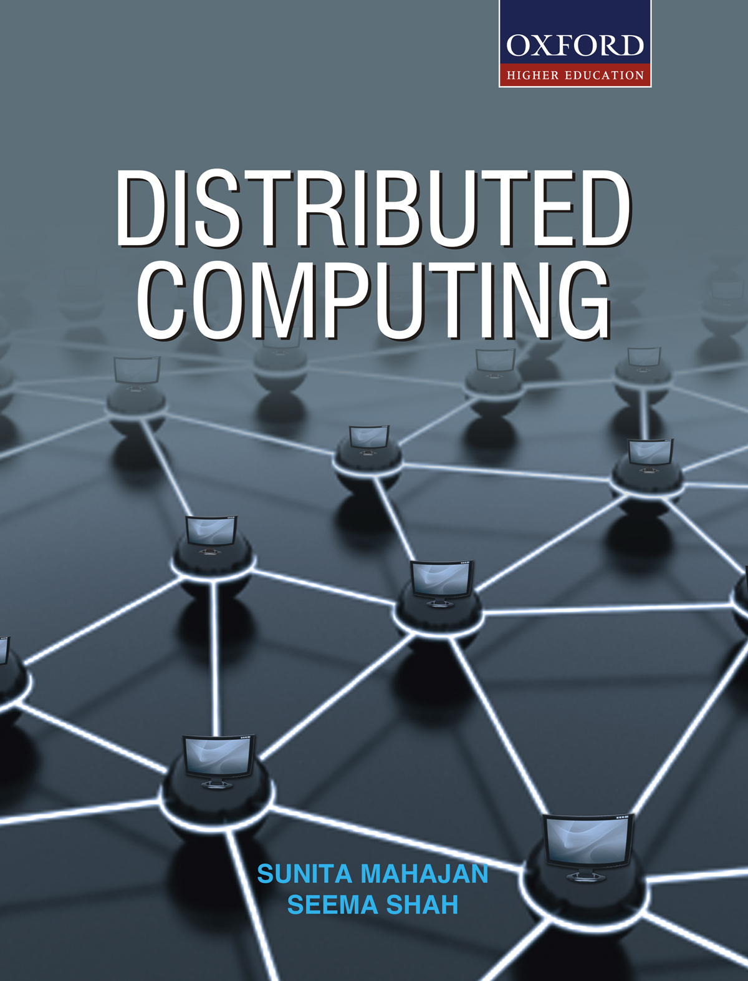
DISTRIBUTED COMPUTING
Sunita Mahajan, Principal, Institute of Computer Science, MET League of Colleges, Mumbai
Seema Shah, Principal, Vidyalankar Institute of Technology, Mumbai University

Slide 2
Chapter – 13
Emerging Trends in Distributed Computing

Slide 3
Topics
Introduction to Emerging Trends
Grid Computing
Service Oriented Architecture (SOA)
Cloud Computing
Future Trends

Slide 4
Introduction to Emerging Trends

Slide 5
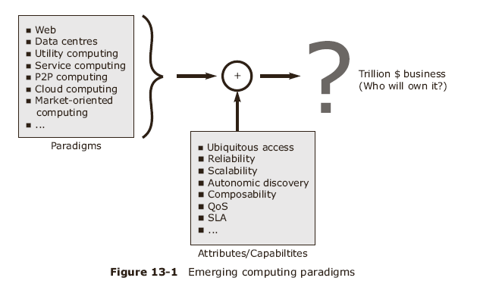
1. Introduction to Emerging Trends

Slide 6
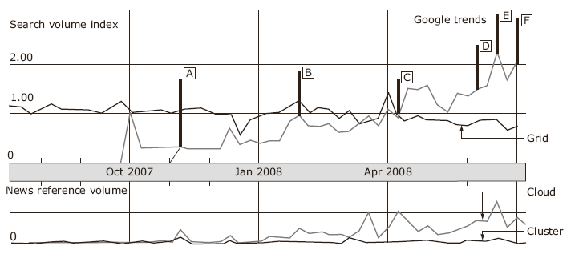
Google Search Trends

Slide 7
Grid Computing

Slide 8
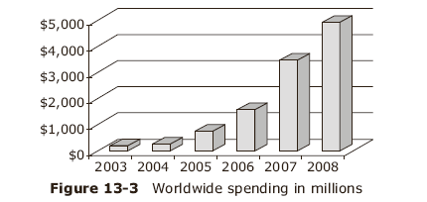
2. Grid Computing
Grids are geographically distributed systems
Consist of underutilized resources , available and accessible via a single interface
Increasing Revenues spent in Grid Computing

Slide 9
Grid working for a HPC
User submits a job requiring high computation from a low end Work Station
A server collects requests from similar users and schedules them based on
  Existing types of resources
  Their capabilities
  Current work load
Submitted jobs are run on the selected computer nodes and results combined later

Slide 10
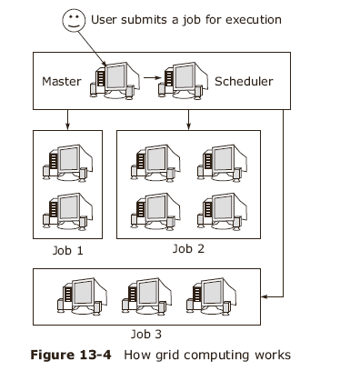
Working of Grid
Grid computing solves larger, more complex problems in shorter time by utilizing existing idle resources

Slide 11
Grid Middleware
Major functions are:
  Optimizing use of widely dispersed resources
  Organizing efficient access to scientific data
  Authenticating users accessing the resources
  Arranging interfaces to local site authorization
A set of grid components perform above functions

Slide 12
Grid Components and Services
Communications
Authentication and Authorization
Naming Services and local transparency
Distributed File System
Resource Management
Fault Tolerance
Graphical User Interface

Slide 13
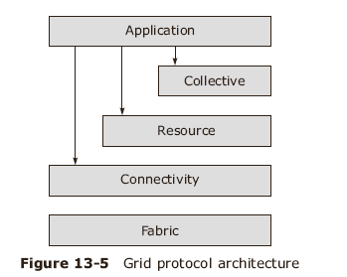
Basic Grid Protocol Architecture
Service Providers
Service Brokers
Service Requesters
Also are part of Grid

Slide 14
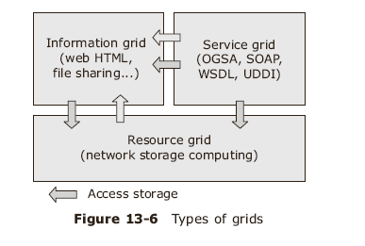
Three Categories of Grid

Slide 15
Computational Grid Characteristics
Made up of clusters of clusters
Enable CPU scavenging for better resource utilization
provide computational power for compute-intensive jobs
Provide instant access on demand

Slide 16
Major Factors affecting performance
Scheduling
Load Balancing
Automatic Deployment
Topology Resolution
Collision Resolution
Fail-over
Checkpoints
Node matrices
Data Grid Integration
Grid Events and Pluggability

Slide 17
Data Grid
Large datasets can be stored in repositories
Data grid provide services to distributed data-intensive applications
  Data replication
  Data invalidation
  Data backup
  Distributed transactions
  Data affinity/partitioning

Slide 18
Service Grid
Grid services available independent of their location, implementation, hardware platform
Transparent access to remote libraries and applications
Service grid comprises of services available on Internet:
  Search engines
  ASP
  Authorization services
  emails

Slide 19
Grid Computing Applications
Distributed computing
High Throughput
On-demand
Data-intensive
Collaborative
OGSA : Open Grid Services Architecture – evolving grid standard standard
OGSI : open Grid Services Infrastructure

Slide 20
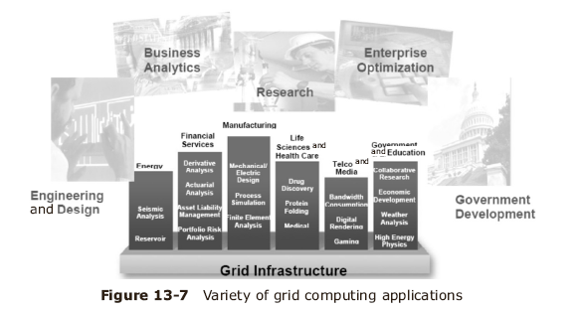
Grid Computing Applications

Slide 21
Simulators
Role of a simulator is to assess whether the grid design will meet the expected application workload response times and throughput
OptorSim and GridSim are two such simulators

Slide 22
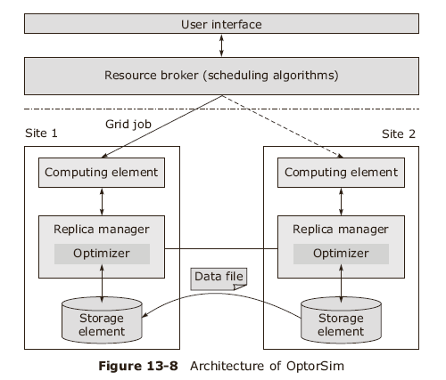
OptorSim

Slide 23
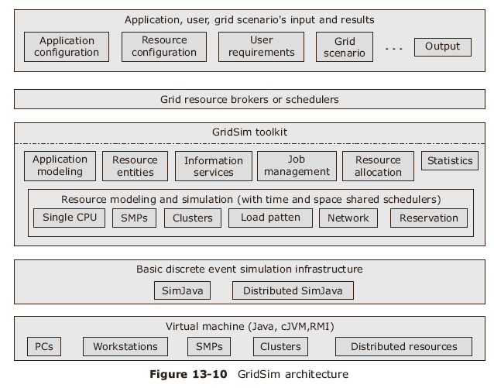
GridSim

Slide 24
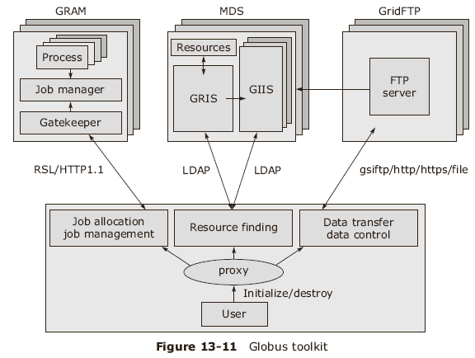
Globus Toolkit
Open Source Grid-building toolkit

Slide 25
Service Oriented Architecture

Slide 26
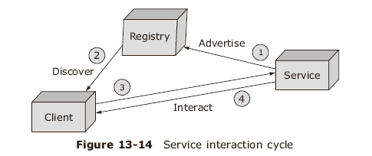
3. Service Oriented Architecture
A style of building reliable distributed systems
SOA delivers functionalities as services emphasizing loose coupling between interacting services

Slide 27
Characteristics of Service
Service- a software component accessed via a network
Services defined by well-published interfaces
Services are loosely coupled and promote location transparency
Services encapsulate reusable business services
They communicate with each other via messages passing

Slide 28
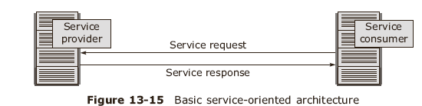
Overview of SOA
Services are natural building blocks allowing to organize capabilities naturally, similar to objects and components
SOA consists of a service provider and service consumer that requested a service
Loose coupling is closely associated with SOA
Its benefits are: flexibility, scalability, replacability and fault tolerance

Slide 29
SOA and Web Services
XML ( eXtensible Markup Language )
SOAP ( Simple Object Access Protocol)
WDSL ( Web Services Description Language )
HTTP and HTTPS are ubiquitous and do not raise issues of firewall traversal

Slide 30
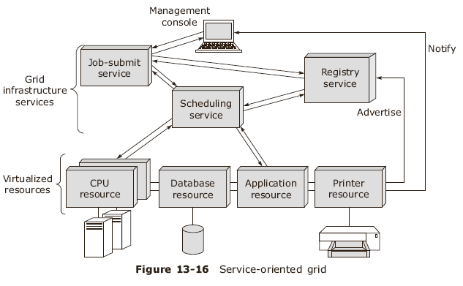
Service Oriented Grid

Slide 31
SOA Design and Development
Identify different units of business logic and work units
Explain functionality of various units in terms of services
Identify core infrastructure services
Identify major links of common functionality between different services
Capture service functionalities in terms of services
Define events of interest in the service
Create workflows to enable service choreography
Publish services in a registry or multiple registries

Slide 32
Cloud Computing

Slide 33
4. Cloud Computing
Cloud is a type of parallel and distributed system consisting of a collection of interconnected and virtualized computers
These are dynamically provisioned on demand and accessible through Web 2.0 technologies
The idea is to scale the application by deploying it on a grid of commodity hardware boxes

Slide 34
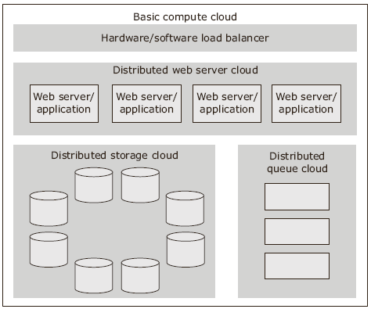
Compute Cloud

Slide 35
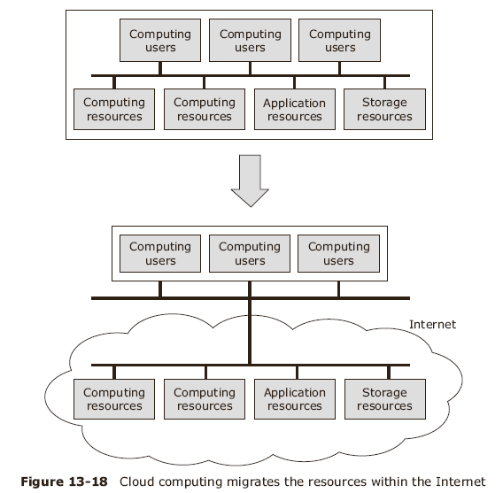

Slide 36
Cloud Computing Features
Off-site resources
Availability on demand
Payment Mechanism
Web-based nature
  Self-healing
  SLA-driven
  Multi-tenancy
  Service-oriented
  Virtualization
  Linear scalability

Slide 37
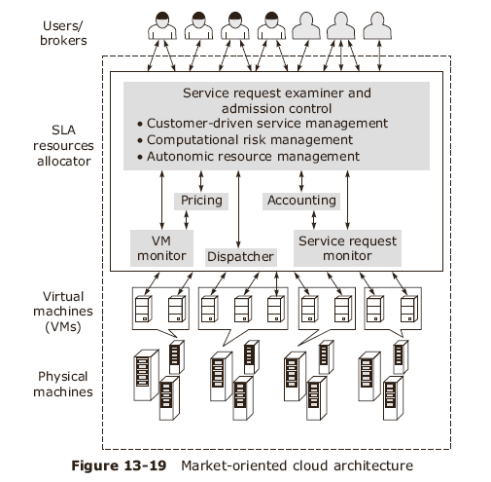
Cloud Computing Architecture
There are four options

Slide 38
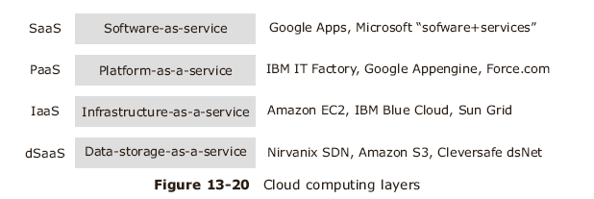
Cloud computing services

Slide 39
Emerging Trends in Future

Slide 40
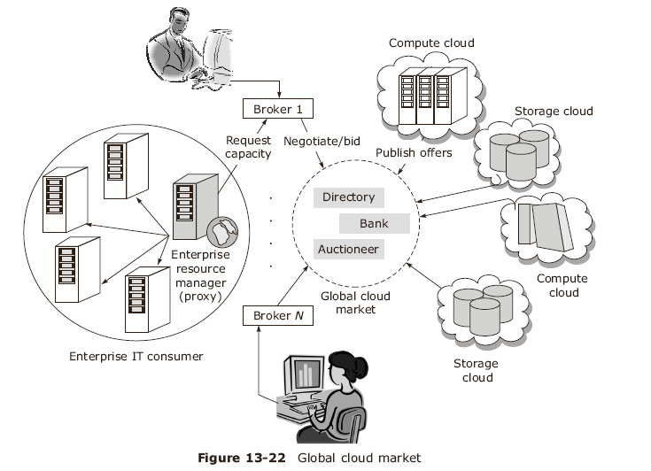
5. Future of Emerging Trends

Slide 41
Summary
Emerging trends give more stress on web applications
Grid computing uses geographically distributed systems to solve large complex problems
SOA refers to a style of building reliable distributed systems to deliver functionalities as services
Cloud computing consists of utilizing parallel and distributed system consisting of interconnected and virtualized computers

